Slide 1
Introduction to Variables, User Input/Output, Data Type Conversion
Course Title: Programming Language II Course Code: CSE 111 Semester: Summer 2020 Lecture-2

Slide 2
Last Lecture
Introduction to Python
History of Python
Beauty of Python
Drawbacks of Python
Applications of Python
Installation of IDE

Slide 3
Today’s Lecture
Variables
Naming convention
Declaration
Data types
User Input
input() function
User output
print() function

Slide 4
Variables
A python variable is a reserved memory location to store values.
Every value in Python has a Datatype. Like –
Number
String
List
Dictionary
Tuple
Variables can be named anything following the naming conventions.
Variables are integral part of any python program.
A1 | A2 | A3 | A4
B1 | B2 | B3 | B4
C1 | C2 | C3 | C4
D1 | D2 | D3 | D4
E1 | E2 | E3 | E4
F1 | F2 | F3 | F4
G1 | G2 | G3 | G4
H1 | H2 | H3 | H4
RAM

Slide 5
Variable Naming Convention
Begin with lowercase letters. For example,
car = "Lamborghini" , robot = "Baymax", balance = 100.65
Use ‘_’ between the words in a variable. For example,
fav_car = "Lamborghini" , owned_robot = "Baymax", my_balance = 100.65
Capitalization naming convention. For example,
favCar = "Lamborghini" , ownedRobot = "Baymax", myBalance = 100.65
Never start a variable name with digits or dollar signs. For example,
$car = "Lamborghini" , 9cRobot = "Baymax", $myBalance = 100.65
Never use the characters 'l' (lowercase letter L), 'O' (uppercase letter O), or 'I' (uppercase letter I) as single character variable names. In some fonts, these characters are indistinguishable from the numerals one and zero. When tempted to use 'l’, use 'L' instead.

Slide 6
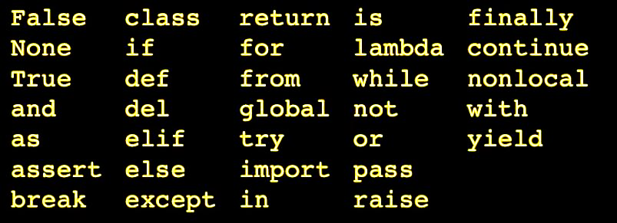
Keywords in Python
There are some reserved word that cannot be used as variable name. Like:

Slide 7
Basic Data Types
Integer/int : positive / negative whole numbers. For example: 5 , 4 , -10 etc.
float: postivie/negative floating point numbers. For example: 5.5 , 4.1 etc
String/str: Array/Collection of characters like word, sentence. For example: “Hello” , “Hello World” etc.
Boolean: has only 2 values: True or False. Mainly used in conditions.

Slide 8
Declaring variables
Every variable in Python is an Object as Python is Object Oriented.
Variable declaration does not require any type.
Syntax: var_name = value
For example,
Variables in Python are dynamically typed. For example,
A1 | A2 | A3 | A4
B1 | B2 | B3 | B4
C1 | C2 | C3 | C4
D1 | D2 | D3 | D4
E1 | E2 | E3 | E4
F1 | F2 | F3 | F4
G1 | G2 | G3 | G4
H1 | H2 | H3 | H4
Output:
<class 'str'>
Hello there.
s = "Hello there." print(type(s))
print(s)
s = "Hello there."
print(type(s))
s = 2020
print(type(s))
Output:
<class 'str'>
<class 'int'>
RAM

Slide 9
Basic Arithmetic Operations
a + b : Addition
a – b : Subtraction
a * b: Multiplication
a / b: Division
a ** b : Exponentiation
a // b: Floor division
a % b: Modulus
If a = 15 and b = 4,
15 + 4 = 19
15 - 4 = 11
15 * 4 = 60
15 / 4 = 3.75
15 ** 4 = 50625 #15*15*15*15
15 // 4 = 3 #the floor division
15 % 4 = 3 #remainder of 15÷4

Slide 10
Deleting a Variable
You can also delete variable using the command del "variable name". For example,
In the example , we deleted variable greet, and when we proceed to print it the second time, we get error "variable name is not defined" which means greet is not pointing to any value.
greet = "Good Morning"
print(greet)
del greet
print(greet)
Good Morning
greet
Output:
Good Morning
NameError: name 'greet' is not defined

Slide 11
User input
Use input ("prompt") to take input from user.
input() pauses program execution to allow the user to type in a line of input from the keyboard.
Once the user presses the Enter key, all characters typed before pressing Enter are read and returned as a String.
Input:
Output:
Welcome to CSE111.
s = input() The program will wait for user input.
print(s)
Welcome to CSE111.
Input:
Output:
Hello Alice
s = input("Enter you name: ")
print("Hello " + s)
Enter your name: Alice

Slide 12
Limitation of input() function
input() always returns a string.
Convert it to other types according to your need.
For example,
n = input("Enter a number: ")
print(n+10)
In the print statment n is a string and 10 is an integer. The machine cannot concat a string to an integer.
n = input("Enter a number: ")
print(int(n)+10)
In the print statemnt we converting n to an integer. So now we have 15 + 10 in the print statement.
Input:
Output:
25
Input:
Output:
TypeError: can only concatenate str (not "int") to str
Enter a number: 15
Enter a number: 15

Slide 13
Type Conversion
int(a) : This function converts any data to integer.
int(string,base) : This function converts any data to integer of given base.
float() : This function is used to convert any data to a floating point number.
str() : This function converts any data to a string.
Examples:
x = int(1) # x will be 1 y = int(2.8) # y will be 2 z = int("3") # z will be 3
y = float(2.8) # y will be 2.8 z = float("3") # z will be 3.0 w = float("4.2") # w will be 4.2

Slide 14
User output: print() function
To display objects to the console, pass them as a comma-separated list of argument to print().
print(<obj>, ..., <obj>)
By default, print() separates each object by a single space and appends a newline to the end of the output:
fName = "David"
lName = "Smith"
print("Name:",fName,lName)
print("Hello",fName,lName)
Output:
Name: David Smith
Hello David Smith

Slide 15
Keyword Argument ‘sep’
Adding the keyword argument sep=<str> causes objects to be separated by the string <str> instead of the default single space:
print ("MM DD YYYY")
print("06","21","2020")
print("06","21","2020",sep=".")
print("06","21","2020",sep="-")
print("06","21","2020",sep="/")
Output:
MM DD YYYY
06 21 2020
06.21.2020
06-21-2020
06/21/2020

Slide 16
Keyword Argument ‘end’
The keyword argument end=<str> causes output to be terminated by <str> instead of the default newline.
For example,
Now if we write,
Output:
I am a Marvel fan.
I love Iron Man.
I love Captain America.
I love Thor.
print("I am a Marvel fan.")
print("I love Iron Man.")
print("I love Captain America.")
print("I love Thor.")
print("I am a Marvel fan.",end=" ")
print("I love Iron Man.",end=" ")
print("I love Captain America.",end=" ")
print("I love Thor.")
Output:
I am a Marvel fan. I love Iron Man. I love Captain America. I love Thor.

Slide 17
Summary
A variable is a reserved memory location to store values. It can have any name as long as we are following the naming conventions.
We can use input() function to take input. But it has a limitation that it returns user input as a String.
We can use print() function to show output.
print() function has a few arguments like sep=<str> , end = <str> etc.

Slide 18
Next Lecture
Concept of conditional statement
Logical operators
Conditional Statements
if statement
if..else statement
if..elif..else statement
Nested if statement
Logical connectives

Slide 19


